Slide 1
Final project: Encoding and Decoding Touch-Tone Signals

Slide 2
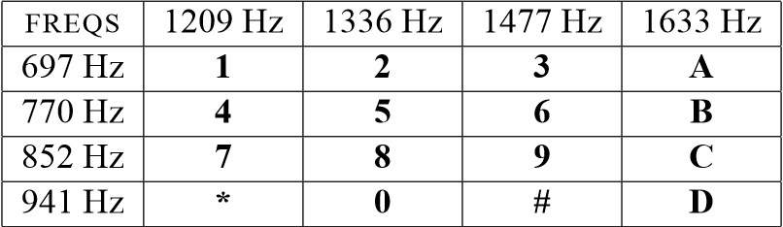
Background: Telephone Touch Tone Dialing
Telephone touch-tone pads generate dual tone multiple frequency(DTMF) signals to dial a telephone.
When any key is pressed, the sinusoids of the corresponding row and column frequencies are generated and summed ,hence dual tone.
Notes:
電話按鍵板可產生雙音多頻 (DTMF) 訊號來撥打電話。當按下任一鍵時，會產生對應行和列頻率的正弦波並相加，產生雙音。

Slide 3
Extended DTMF encoding table for Touch Tone dialing. When any key is pressed the tone of the corresponding column and row are generated and summed. Key A-D (in the fourth column) are implemented on commercial and household telephone sets, but are used in some military and other signaling application.
Notes:
用於按鍵式撥號的擴充 DTMF 編碼表。 當按下任意鍵時，會產生對應列和行的音調並進行求和。 鍵 A-D（第四列）在商用和家用電話機上實現，但也用於一些軍事和其他信令應用。

Slide 4
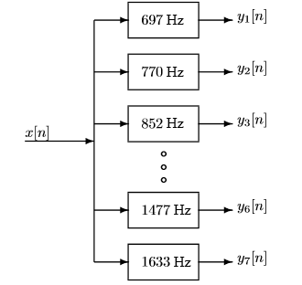
DTMF Decoding
Divide the time signal into short time segment representation individual key presses.
Filter the individual segments to extract the possible frequency component. Bandpass filters can be used to isolate the sinusoidal components.
Notes:
將時間訊號分為表示各個按鍵的短時間段。過濾各個片段以提取可能的頻率分量。 帶通濾波器可用於隔離正弦分量。

Slide 5
DTMF Decoding
Determine which two frequency components are present in each time segment by measuring the size of the output signal from all of the bandpass filters.
Determine which key was pressed, 0-9, A-D, * or ,# by converting frequency pairs back into key
names according to Fig.1.
Notes:
透過測量所有帶通濾波器的輸出訊號的大小來確定每個時間段中存在哪兩個頻率分量。透過將頻率對轉換回按鍵來決定按下了哪個按鍵，0-9、A-D、* 或 ,# 根據圖1命名。

Slide 6
Filter bank consisting of bandpass filters(BPFs) which pass frequencies corresponding to the eight DTMF components frequencies listed in Fig.1. The number is each box is the center frequency of the BPF.
Notes:
濾波器組由帶通濾波器（BPF）組成，其透過與圖 1 中列出的八個 DTMF 分量頻率相對應的頻率。 每個方框的數字就是BPF的中心頻率。

Slide 7
Signal Concatenation
A very long music signal was created by joining together many sinusoids. When two signals were played one after the other, the composite signal was created by the operation of concatenation.
xx = [ xx, xxnew ];
Notes:
透過將許多正弦波連接在一起來創建很長的音樂訊號。 當兩個訊號依序播放時，透過串聯操作建立複合訊號。

Slide 8
Encoding from a Table
ftable = [1;2;3;4;5]*[80,110]
fs = 8000;
xx = [ ];
disp(’--- Here we go through the Loop ---’)
keys = rem(3:12,10) + 1;
for ii = 1:length(keys)
kk = keys(ii);
xx = [xx,zeros(1,400)];
krow = ceil(kk/2);
kcol = rem(kk-1,2) + 1;
xx = [xx, cos(2*pi*ftable(krow,kcol)*(0:1199)/fs) ];
end

Slide 9
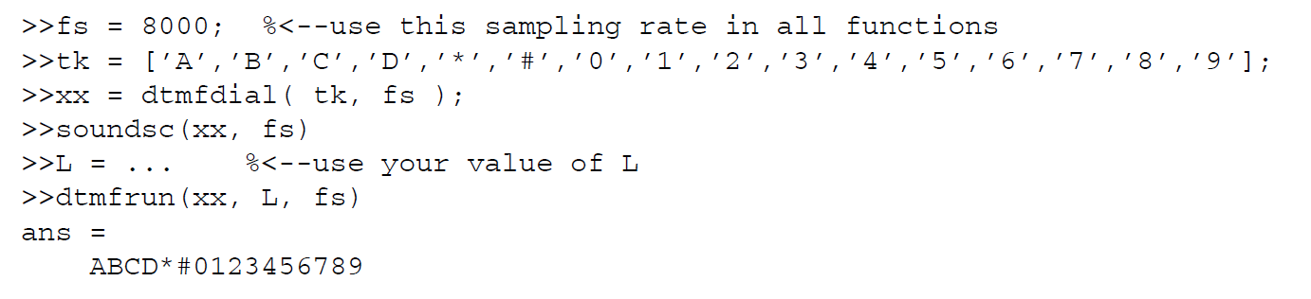
Testing the DTMF system

Slide 10
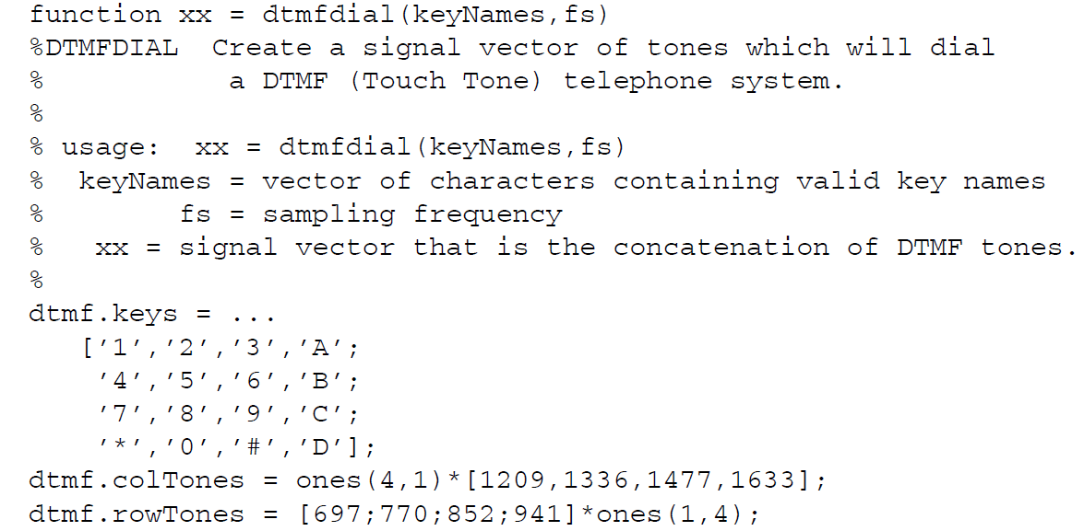
DTMF Dial Function

Slide 11
Testing the DTMF system
Matching

Slide 12
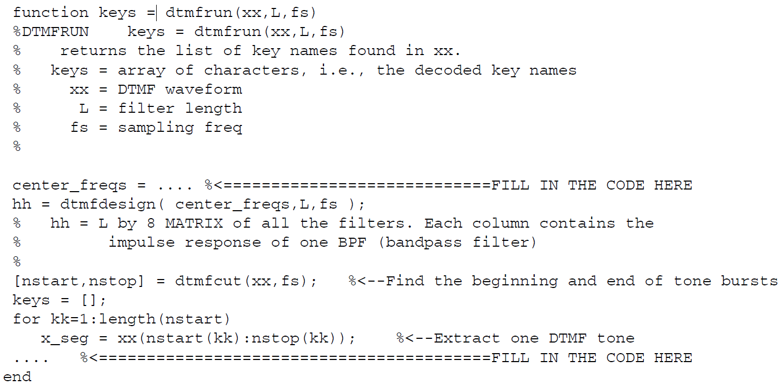
DTMF Decode Function: dtmfrun.m

Slide 13

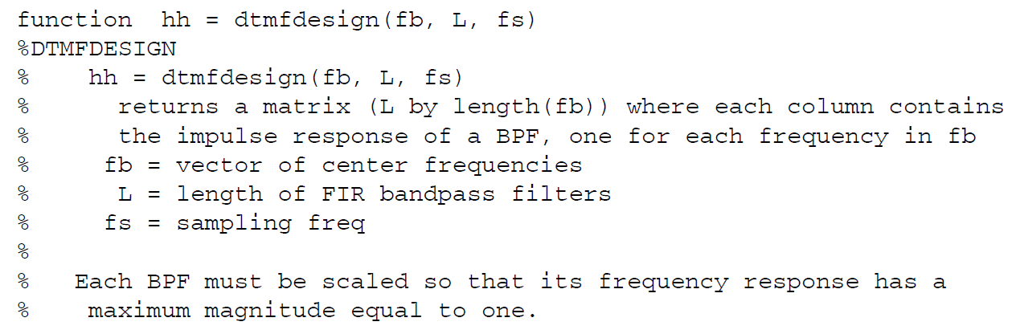
Simple Bandpass Filter Design : dtmfdesign.m

Slide 14
DTMF Decode Function: dtmfrun.m

Slide 15
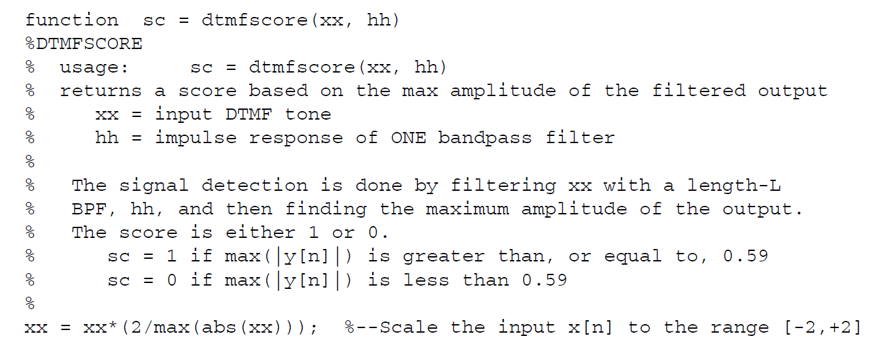
A Scoring Function: dtmfscore.m

Slide 16
DTMF Decode Function: dtmfrun.m
dtmfscore.m

Slide 17
期末報告
分組
5人一組
口頭報告(需繳交ppt檔)
每組準備一份ppt簡報，所有人輪流上台報告與回答問題
報告中詳細列出每個人的負責項目與貢獻度
充分展現團隊合作，所有人對報告內容都要清楚了解
報告需要包括以下章節
介紹
問題描述與分析
Matlab程式解說與流程圖
結果與討論
每個人的負責項目與貢獻度
參考文獻
助教驗收程式時間：12/11

